Slide 1

Tamar
IBS Recommender System
Personalized Recipe Recommendations & Symptom Assistant for Digestive Health
Mid-Workshop Pitch | Tamar HealthTech

Slide 2
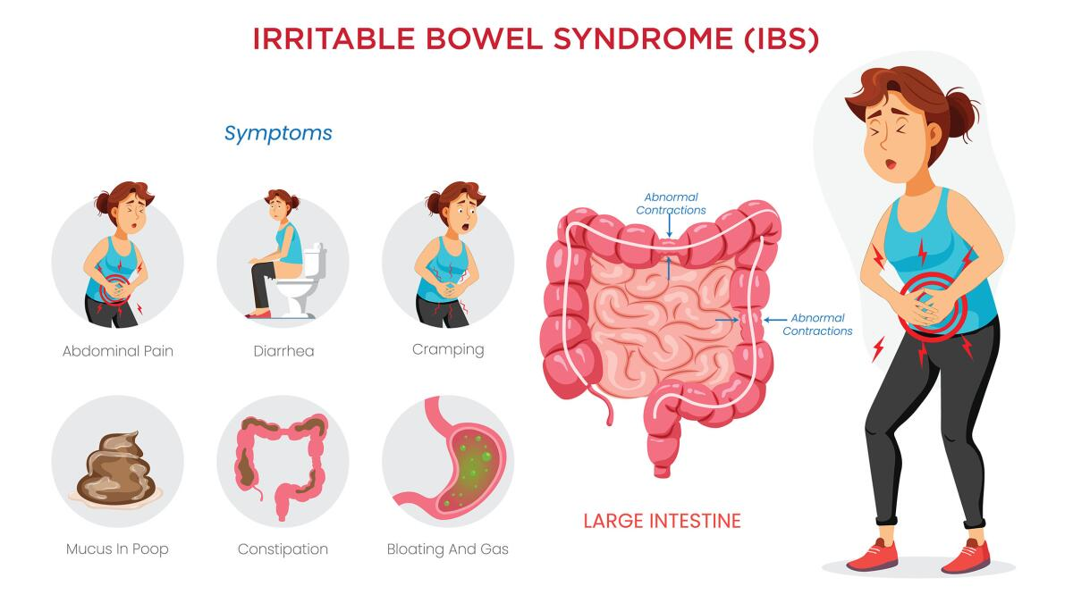
IBS?

Slide 3




Our Team
Ram Kedem
Itai Mor
Yael Sagi
Yehonatan

Slide 4
Product Roadmap & Diet Support Evolution
Phase-by-phase scaling from recommendation algorithms to deep clinical diet personalization.
NEXT MILESTONE
PHASE 1: CURRENT FOCUS
Recipe Recommendation
Engage users with high-quality recipes.
• Personal flavor profile builder & taste onboarding
• User Cookbooks for saving & organizing recipes
• Step-by-step interactive cooking mode with timer
• Rating & recipe interaction history telemetry
PHASE 2: NEXT STEP
Specialized IBS Support
Address direct gut health & symptom logging.
• Low-FODMAP ingredient filtering & alternatives
• Daily food & gut symptom logger with severity scale
• Smart trigger food identification algorithms
• Clinically aligned gastrointestinal health insights
PHASE 3: FUTURE VISION
Universal Diet Platform
Scale to support any dietary condition.
• Advanced medical profiles (Diabetes, Celiac, Heart)
• Cross-diet overlapping filters (e.g. Low-FODMAP + Vegan)
• Family profile support with overlapping restrictions
• Smart allergen-replacement shopping lists

Slide 5

Scan Me!

Slide 6
Tamarai.Tech

Slide 7
The Challenge Personalized Nutrition
Individual Triggers
Dietary triggers (specifically FODMAPs) are highly personalized. What is safe for one patient might trigger a painful flare-up in another.
Platform Gap
Conventional recipe search tools offer basic allergen filters, but completely lack health-first, adaptive, and personalized exclusions.
Market Size
Irritable Bowel Syndrome (IBS) affects over 10-15% of the global population, severely impacting quality of life through food anxiety.

Slide 8
Key Platform Capabilities
Personalized Cooking
Curated Recipe Engine
Analyzes raw ingredients and nutrition datasets to recommend tailored meals. Respects strict allergens, specific FODMAP exclusion levels, and personal health goals without compromising flavor.
Chat with Tamar
AI Health Assistant
Powered by Google Gemini. Provides real-time answers about ingredient safety, suggests IBS-friendly substitutions, translates dietary restrictions on the fly, and guides meal preparation.
Insights & Analytics
Symptom Tracker
Correlates logged user interactions (likes, saves, completions) and symptom flares to identify hidden dietary triggers. Translates complex biological trends into clean, actionable dashboards.

Slide 9
Data Ecosystem
Merging large-scale recipes with real-time user activity logs to drive highly tailored suggestions.
Data Source | Type | Key Attributes | Volume
Food.com Dataset | Recipe Catalog | Ingredients, instructions, preparation times, and nutritional arrays | 100,000+ Recipes
Food.com Dataset | Feedback | Rating | 980,000+ Interactions
Monash University | Research result | FODMAP filters | ~100

Slide 10
Data Preprocessing & Transformation Pipeline
01
Recipe Feature Engineering & Normalization
Extracts preparation times, total steps, and counts ingredients. Parses the raw stringified nutrition arrays into individual macros (calories, protein, carbohydrates) to calculate macro-nutrient ratios.
02
Implicit-to-Explicit Rating Mapping
Converts qualitative interaction logs into quantitative rating signals. Maps interaction types to weights (Viewed: 1.5, Started: 3.5, Liked: 4.5, Saved: 5.0, Completed: 5.0) to model user preferences.
03
Strict Dietary Constraint Filtering
Acts as a hard pre-filtering layer. Before running recommendation models, the database is queried to prune recipes containing user-specific absolute triggers (e.g. gluten, lactose, high-FODMAPs).

Slide 11
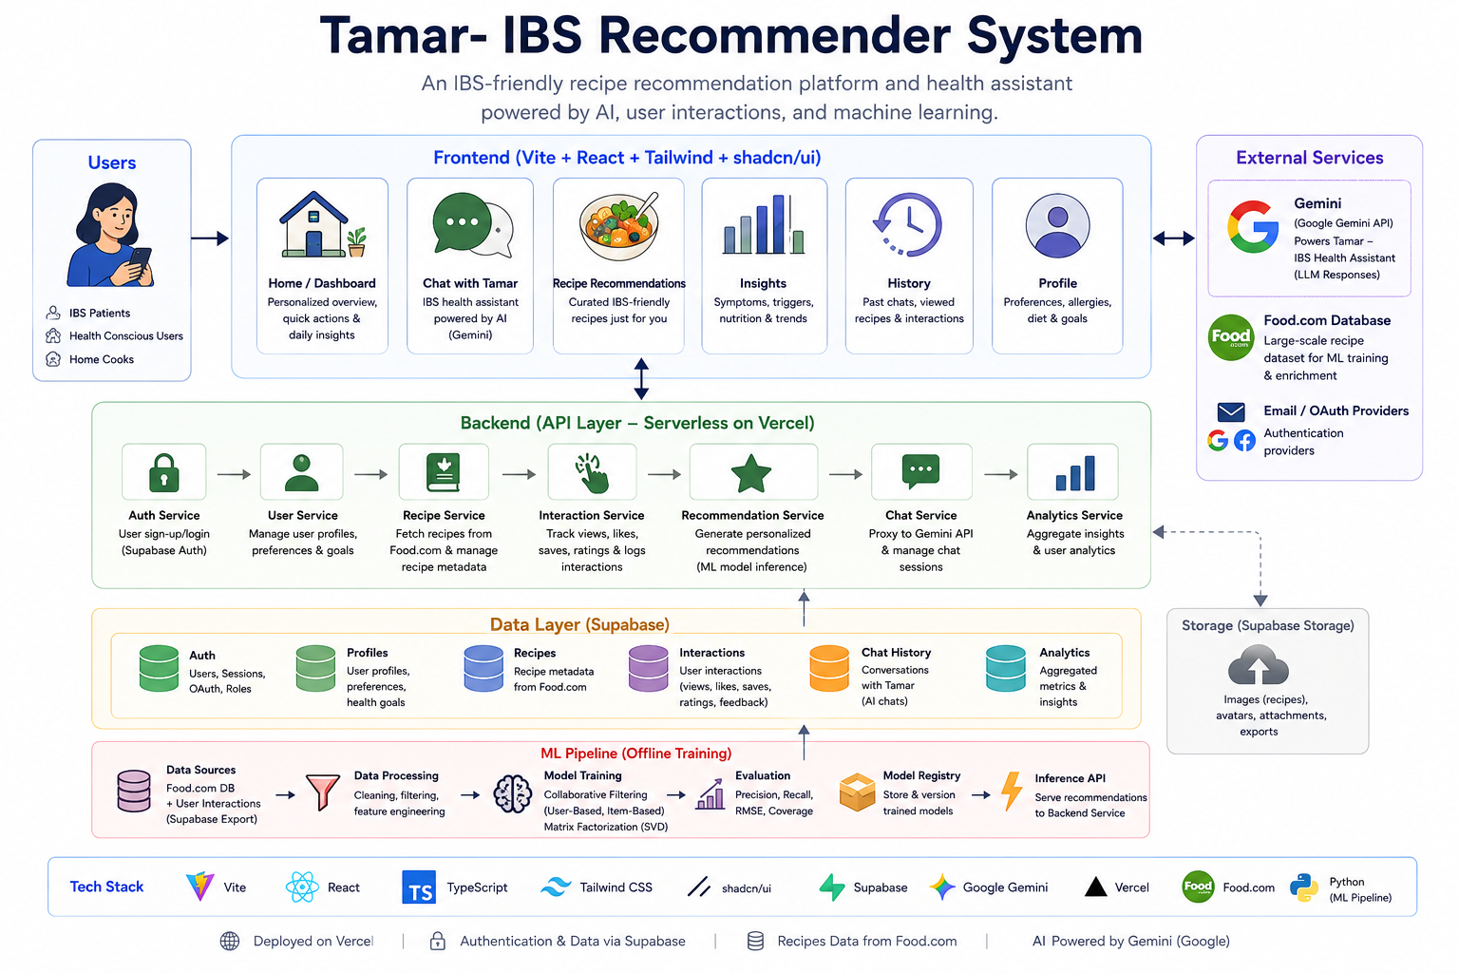
Notes:
• Frontend (React + Vite): Delivers a fast user dashboard, chat assistant interface, symptom logs, and recipe discovery components utilizing Tailwind and shadcn/ui.
• Backend API Layer (Vercel): A serverless Vercel function framework orchestration layer, separating routing logic for auth, user settings, chats, and recommendations.
• Data Layer (Supabase): PostgreSQL database stores user preferences, chat logs, recipe tables, and interactions. Storage buckets serve static models and media.
• Offline ML Pipeline: Python-based training script that runs on schedule to sync new ratings, train CF models (SVD), registry version files, and push coefficients.

Slide 12
Algorithmic Strategies
Content-Based Active Learning
Targeting the Cold-Start Problem
Feature Vectors: Repositions recipe metadata (cooking speed, complexity, ingredients, macro ratios) as latent item dimensions.
K-Means Clustering: Partitions the recipe search space into K=5 distinct culinary profiles.
Centroid Medoids: Mathematically isolates representative recipes per cluster, constrained by global popularity and low variance.
Cosine Similarity: Scores remaining items relative to the user's vector: (A • B) / (||A|| * ||B||).
Collaborative Filtering
SVD Matrix Factorization: Trains an offline Surprise SVD model combining active user ratings and Food.com history.
Neighborhood Benchmarks: Implements baseline User-Based and Item-Based CF algorithms for prediction validation.
Catalog Padding: Normalizes rating vectors with catalog placeholders to secure full recipe coverage.
Score Normalization: Projects raw prediction numbers into a display-friendly 78% - 98% confidence range for user trust.

Slide 13
Future Product Roadmap
Engine improvements
Add more user-based indicators to determine the rating. Implement machine learning classification to correlate self-reported symptom logs with consumed meals, flagging hidden patient-specific food triggers.
Recipes Gallery Expand the dynamic, card-based interface to support growth from hundreds of curated photos to a full dataset of all our 100,000 recipes.
RS-Chat embedding Integrate the collaborative filtering recommender engine into the AI health assistant, enabling real-time, context-aware meal suggestions directly within active chat conversations.

Slide 14
Enjoy food again!
Tamar | IBS proof food recommender system

Slide 15
Enjoy food again!
Tamar | IBS proof food recommender system

